Slide 1

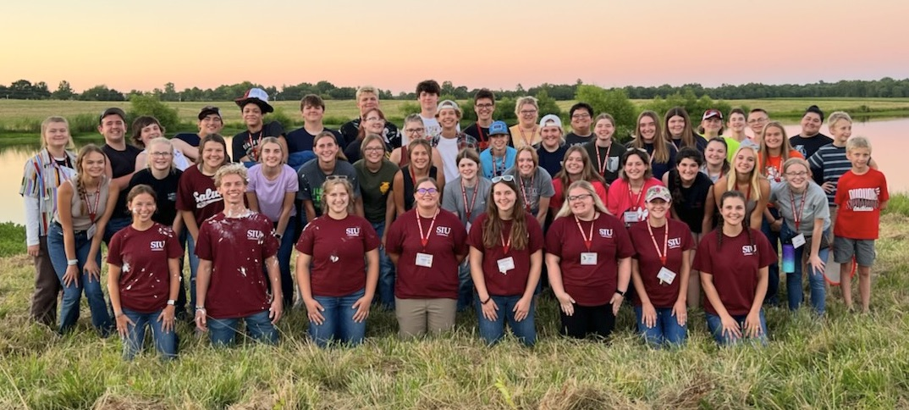
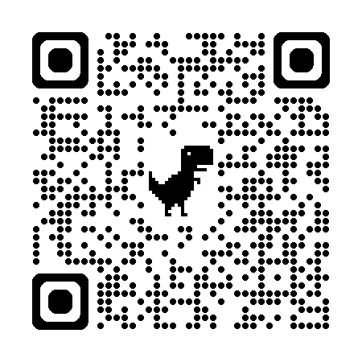
2026 SIU Agriculture Education Camp July 13-15, 2026
Where: Touch of Nature, Southern Illinois University
Who: High school students who may be interested in a Career in Agriculture Education
How to sign up: Scan the QR Code
Camp is 100% free to students!

